Slide 1
A Case Study of
TCP/IP Tunings for High Performance Interconnects
Jenett Tillotson
Senior Systems Engineer
NCAR
November 13, 2020
Notes:
NOTE: Background image can be used as is or changed for a particular presentation in the “Slide Master” button found under the “View” tab.

Slide 2
Cheyenne
4,032-node SGI/ICE machine
SLES12 SP4
Kernel 4.12.14
1Gb/s Ethernet for inner rack communication (booting, syslog, etc.)
1Gb/s Ethernet for hardware management (power on/off, console)
EDR Infiniband interconnect
Bandwidth: 100Gb/s
9-dimensional hypercube
IPoIB in Datagram mode (MTU: 4092)
GPFS
IPoIB for control communications
RDMA for data transport
HPCSYSPROS20 TCP/IP Tuning

Slide 3
sysctl.conf
net.core.rmem_default=4194304
net.core.wmem_default=4194304
net.core.rmem_max=4194304
net.core.wmem_max=4194304
net.ipv4.tcp_mem=16777216 16777216 16777216
net.ipv4.tcp_wmem=4096 16384 262144
net.ipv4.tcp_rmem=4096 87380 6291456
net.ipv4.neigh.default.gc_thresh1=12216
net.ipv4.neigh.default.gc_thresh2=14216
net.ipv4.neigh.default.gc_thresh3=14964
net.ipv4.neigh.default.gc_interval=200000
net.ipv4.neigh.ib0.gc_stale_time=200000
net.ipv4.neigh.ib0.mcast_solicit=9
net.ipv4.neigh.default.ucast_solicit=9
net.ipv4.neigh.default.mcast_solicit=9
net.ipv4.neigh.ib0.mcast_solicit=9
net.core.somaxconn=12000
net.core.netdev_max_backlog=250000
net.core.optmem_max=4194304
net.ipv4.tcp_max_syn_backlog=16384
net.ipv4.tcp_timestamps=0
net.ipv4.tcp_window_scaling=1
net.ipv4.tcp_tw_reuse=1
net.ipv4.tcp_syn_retries=12
net.ipv4.tcp_sack=1
HPCSYSPROS20 TCP/IP Tuning

Slide 4
Network Buffers
net.core.rmem_default=4194304
net.core.wmem_default=4194304
net.core.rmem_max=4194304
net.core.wmem_max=4194304
net.ipv4.tcp_mem=16777216 16777216 16777216
net.ipv4.tcp_wmem=4096 16384 262144
net.ipv4.tcp_rmem=4096 87380 6291456
net.ipv4.neigh.default.gc_thresh1=12216
net.ipv4.neigh.default.gc_thresh2=14216
net.ipv4.neigh.default.gc_thresh3=14964
net.ipv4.neigh.default.gc_interval=200000
net.ipv4.neigh.ib0.gc_stale_time=200000
net.ipv4.neigh.ib0.mcast_solicit=9
net.ipv4.neigh.default.ucast_solicit=9
net.ipv4.neigh.default.mcast_solicit=9
net.ipv4.neigh.ib0.mcast_solicit=9
net.core.somaxconn=12000
net.core.netdev_max_backlog=250000
net.core.optmem_max=4194304
net.ipv4.tcp_max_syn_backlog=16384
net.ipv4.tcp_timestamps=0
net.ipv4.tcp_window_scaling=1
net.ipv4.tcp_tw_reuse=1
net.ipv4.tcp_syn_retries=12
net.ipv4.tcp_sack=1
HPCSYSPROS20 TCP/IP Tuning

Slide 5
Network Buffer Sizes
Bandwidth delay product
Time how long it takes to receive the ACK for a The maximum amount of data on the wire before ACK
Buffer size = bandwidth * RTT
r1i0n0:~ # ping -M do -s 4064 r14i7n35
--- r14i7n35.ib0.cheyenne.ucar.edu ping statistics ---
35 packets transmitted, 35 received, 0% packet loss, time 34802ms
rtt min/avg/max/mdev = 0.088/0.164/0.348/0.064 ms
100Gigabits/sec * 1Byte/8bits * .00034sec = ~4MB
HPCSYSPROS20 TCP/IP Tuning

Slide 6
TCPIP Buffers
Network buffers sizes in bytes (all types of connections)
Set default receive and send buffer size to 4MB
net.core.rmem_default=4194304
net.core.wmem_default=4194304
Set max receive and send buffer size to 4MB
net.core.rmem_max=4194304
net.core.wmem_max=4194304
TCP receive buffer sizes (min default max)
net.ipv4.tcp_rmem=4096 87380 6291456
Total number of 4KB memory pages allowed for all TCP buffer space (min pressure max)
net.ipv4.tcp_mem=16777216 16777216 16777216
HPCSYSPROS20 TCP/IP Tuning
Notes:
Network buffer sizes – in bytes and all the following buffers are in bytes as well. default depends on memory at boot time
TCP receive buffer sizes – 4096 and 87380 are default. 6MB max is the maximum
Total TCP buffer space – 16 billion 4K pages

Slide 7
ARP Tunings
net.core.rmem_default=4194304
net.core.wmem_default=4194304
net.core.rmem_max=4194304
net.core.wmem_max=4194304
net.ipv4.tcp_mem=16777216 16777216 16777216
net.ipv4.tcp_wmem=4096 16384 262144
net.ipv4.tcp_rmem=4096 87380 6291456
net.ipv4.neigh.default.gc_thresh1=12216
net.ipv4.neigh.default.gc_thresh2=14216
net.ipv4.neigh.default.gc_thresh3=14964
net.ipv4.neigh.default.gc_interval=200000
net.ipv4.neigh.ib0.gc_stale_time=200000
net.ipv4.neigh.ib0.mcast_solicit=9
net.ipv4.neigh.default.ucast_solicit=9
net.ipv4.neigh.default.mcast_solicit=9
net.ipv4.neigh.ib0.mcast_solicit=9
net.core.somaxconn=12000
net.core.netdev_max_backlog=250000
net.core.optmem_max=4194304
net.ipv4.tcp_max_syn_backlog=16384
net.ipv4.tcp_timestamps=0
net.ipv4.tcp_window_scaling=1
net.ipv4.tcp_tw_reuse=1
net.ipv4.tcp_syn_retries=12
net.ipv4.tcp_sack=1
HPCSYSPROS20 TCP/IP Tuning

Slide 8
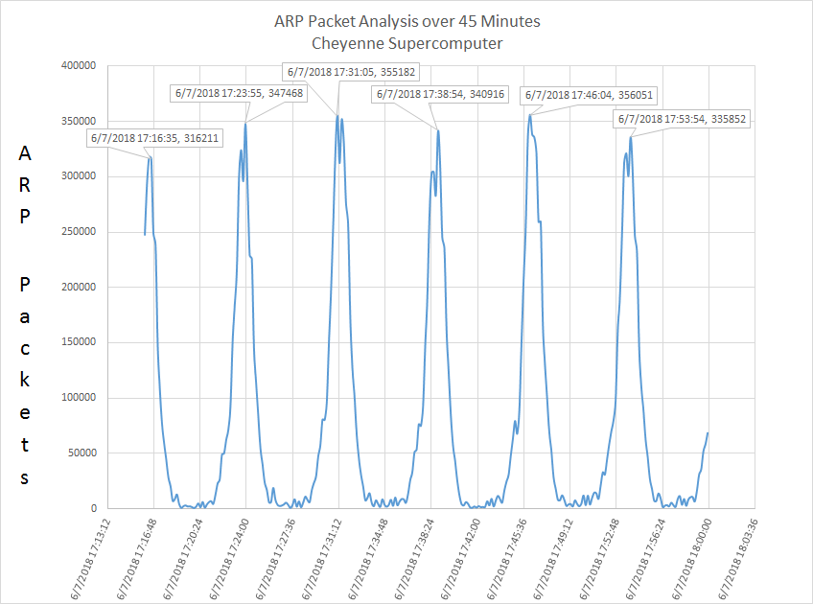
ARP Storms
HPCSYSPROS20 TCP/IP Tuning

Slide 9
ARP Tunings
Number of entries before GC will run (default: 128)
net.ipv4.neigh.default.gc_thresh1=12216
Number of entries that will force a GC run (default: 512)
net.ipv4.neigh.default.gc_thresh2=14216
The max number of entries (default: 1024)
net.ipv4.neigh.default.gc_thresh3=14964
GC will run minimum every 200K seconds (~55hours) (default: 30 seconds)
net.ipv4.neigh.default.gc_interval=200000
Number of unicast probes before asking ARP (default: 3)
net.ipv4.neigh.default.ucast_solicit=9
Number of multicast probes before asking ARP (default: 3)
net.ipv4.neigh.default.mcast_solicit=9
How often to check for stale entries (~55 hours) (default: 60 seconds)
net.ipv4.neigh.ib0.gc_stale_time=200000
HPCSYSPROS20 TCP/IP Tuning
Notes:
Nodes have ~4100 arp entries usually
Gc_stale_time is left at 60 seconds for the ethernet devices

Slide 10
The Rest
net.core.rmem_default=4194304
net.core.wmem_default=4194304
net.core.rmem_max=4194304
net.core.wmem_max=4194304
net.ipv4.tcp_mem=16777216 16777216 16777216
net.ipv4.tcp_wmem=4096 16384 262144
net.ipv4.tcp_rmem=4096 87380 6291456
net.ipv4.neigh.default.gc_thresh1=12216
net.ipv4.neigh.default.gc_thresh2=14216
net.ipv4.neigh.default.gc_thresh3=14964
net.ipv4.neigh.default.gc_interval=200000
net.ipv4.neigh.ib0.gc_stale_time=200000
net.ipv4.neigh.ib0.mcast_solicit=9
net.ipv4.neigh.default.ucast_solicit=9
net.ipv4.neigh.default.mcast_solicit=9
net.ipv4.neigh.ib0.mcast_solicit=9
net.core.somaxconn=12000
net.core.netdev_max_backlog=250000
net.core.optmem_max=4194304
net.ipv4.tcp_max_syn_backlog=16384
net.ipv4.tcp_timestamps=0
net.ipv4.tcp_window_scaling=1
net.ipv4.tcp_tw_reuse=1
net.ipv4.tcp_syn_retries=12
net.ipv4.tcp_sack=1
HPCSYSPROS20 TCP/IP Tuning

Slide 11
The Rest (core)
Max number of connection requests that can be queued for any given listening socket (default: 128)
net.core.somaxconn=12000
Max number of packets queued for processing by the kernel (default: 1000)
net.core.netdev_max_backlog=250000
Max amount of control data allowed per socket (default: 2048)
net.core.optmem_max=4194304
HPCSYSPROS20 TCP/IP Tuning
Notes:
Optmem_max set to same as rmem_max

Slide 12
The Rest (TCP)
Max number of connect requests waiting for ACK
net.ipv4.tcp_max_syn_backlog=16384
Disable TCP timestamps
net.ipv4.tcp_timestamps=0
Allow TCP window scaling
net.ipv4.tcp_window_scaling=1
Allow TIME WAIT socket reuse
net.ipv4.tcp_tw_reuse=1
Double the number of SYN retries
net.ipv4.tcp_syn_retries=12 #(default: 6)
Enable selective ACKs
net.ipv4.tcp_sack=1
HPCSYSPROS20 TCP/IP Tuning
Notes:
Tcp_max_syn_backlog: number of connection request that are waiting for the ACK from the client to complete the connection (defaults based on memory at boot)
Turn off timestamps,
allow window scaling (max window size of 65536, so have a multiplier as an extra field)
allow TIME WAIT socket reuse
Tcp_syn_retries – default: 6
Allow selective acks: ACK particular packets received instead of received “up to”

Slide 13
Hostname -> IP
Host files
Compute nodes
A majority of hostname resolutions will be for compute nodes
Take the burden off of DNS
Storage nodes and network devices
Things that the cluster relies on and cannot operate without
Things that don’t change their IP addresses (often)
A cluster should not rely on DNS in order to be operational
HPCSYSPROS20 TCP/IP Tuning

Slide 14
Best Practices
Tune TCP buffers based on the bandwidth and latency of your interconnect
If you have a large number of nodes (more than 1,000)
Tune ARP
Increase number of connections, particularly if you have a “friendly” protocol like GPFS
SACK
Use host files
It can’t be DNS…It’s DNS
HPCSYSPROS20 TCP/IP Tuning

Slide 15
References
https://community.mellanox.com/s/article/linux-sysctl-tuning
https://fasterdata.es.net/
http://www.psc.edu/tcp-tune
https://www.kernel.org/doc/Documentation/networking/ip-sysctl.txt
https://www.kernel.org/doc/Documentation/networking/ipvs-sysctl.txt
https://www.kernel.org/doc/Documentation/sysctl/net.txt
arp kernel module man page (section 7)
HPCSYSPROS20 TCP/IP Tuning

